Slide 1
InDEXTER
File Indexing by: Lorenzo Dela Cruz, Samuelito Demandante, Leah Tute, Ralph Perdido, Raffie Rapisura

Slide 2
Introduction
File Indexing
the process of providing index to computer file/s to allow easy random access in any record given its file key
the goal of this machine project is for you to develop an application that will facilitate the indexing process (.txt files only).
former shall provide the lookup feature that will allow users to find the path of the indexed files
latter shall index the files in a given path or location in the disc.
The indexing should be done in a recursive manner, crawling and looking for every file in every sub-folder in the given path

Slide 3
Introduction
This paper proposes the development of a file indexer that will explore its effectiveness in terms of disc/storage, memory buffering, and strategy of storing the index-file information in its optimal state
The application will have two modules:
the Index will be able to extract all the computer files; and
the Search module will allow the easy random access in any record given its file key in .txt files only within a specified directory and then collected and saved into a buffer at its optimum state and recursive manner.

Slide 4
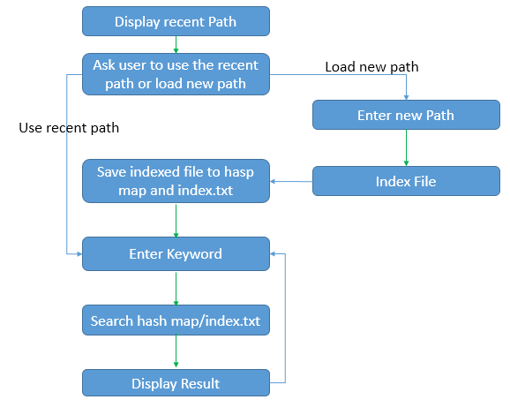
FINAL DESIGN

Slide 5
Methodology
This will be programmed in Java programming language and Eclipse as the Integrated Development Environment (IDE).
Display Recent path- displays the recent path the users used.
Ask user to use recent path or enter new path- ask the user to use recent path that have been use for searching or enter a new path for searching.
Enter New Path-First, enter the directory name to be searched/scraped.
Save Index File to index.txt-The application will crawl and look for every file in the given path directory including its sub-directories that will generate a tree with the .txt file extension which will be stored temporarily in the memory (cache) and save it into index.txt
Enter Keyword-Enter the keyword to be searched in the buffer.
Search keyword from hash map/index.txt -Search the keyword in the buffer with the name similar to the keyword and files that contain that keyword.
Display Output - display the results of the search, the paths where the keyword was found.
Ask for another keyword, if desired -The application will go back to C. to ask for another keyword to be searched in the scraped directory, if desired.

Slide 6
Result!
We tested the program from different computers with different specifications. File size to be searched is 1gb with sub folders inside. Also sub folders contains large text files. The following table shows the result of the test.
Table 1. Specs: Intel Core i3, 2gb RAM, 2.2ghz
Indexing Process
Time taken to index file: 1235.4200 seconds
Before | Peak | After
CPU: 0%-6% | 1%-35% | 0%-3%
Memory: 1.19gb | 1.22gb | 1.19gb

Slide 7
Result!
Table 2. Specs: Intel Core i3, 2gb RAM, 2.2ghz
Searching Process
Time taken to search: 0 second
Before | Peak | After
CPU: 0%-1% | 1%-2% | 0%-1%
Memory: 1.19gb | 1.23gb | 1.20gb

Slide 8
Result!
Table 3. Specs: Intel Core i5, 8gb RAM
Indexing (no indexed file)
Time taken to index: 1039.400 seconds
 | Before | Peak | End
CPU | 6%-7% | 31%-61% | 7%-8%
DISK | 0%-10% | 0%-31% | 0%-11%
MEMORY | 3.9GB | 4.0GB-4.1GB | 4.1GB

Slide 9
Result!
Table 4. Specs: Intel Core i5, 8gb RAM
Indexing (load save indexed file)
Time taken to index: 0.0 seconds
 | Before | Peak | End
CPU | 2%-3% | 30%-36% | 4%
DISK | 0%-5% | 5%
MEMORY | 2.3GB | 2.5GB | 2.5GB

Slide 10
Result!
Table 5. Specs: Intel Core i5, 8gb RAM
Searching
Time taken to search: 0.0 second
 | Before | Peak | End
CPU | 2%-5% | 30% | 2%-4%
DISK | 0% | 0% | 0%
MEMORY | 3.7GB | 3.7GB | 3.7GB

Slide 11
DISCUSSION
Table 1 shows the fluctuation of the CPU usage when files are being indexed. These occur because the file is too large to process. Also, you can see the memory size becomes bigger. It occurs because the files or the indexed files are stored in the memory. Which means it enable the memory to participate in the process of indexing. This will enable the searching process to be a lot faster. However, in the indexing part the user is asked to use the recent indexed file or enter new path to be index. If the user choose to load the save indexed file, indexing process will no longer be acquired. It only loads the file (index.txt) into the memory for searching. With these the indexing process will only accumulate 0.0 second to load the saved file and the searching will accumulate 0.0 second to search the keyword (see Table 4). But if the user chooses to enter a new path which requires to index the new file directories, time taken in indexing process will depend on the size of the file. Moreover, CPU, memory, and disk usage will fluctuate into a higher percentage compared from loading an indexed file (see Table 3 for fluctuations of CPU, memory and disk usage).

